Slide 1

Algorithms for complete Physiological Monitoring During Spaceflight
Aven Zitzelberger – Undergraduate
Dr. Mohammad Ghassemi - Mentor

Slide 2
Motivation:
Continuous, real-time monitoring of astronaut physiology is hard.
Many sensors collectively prone to malfunction
Repair/replacements not available
Current approaches limit mobility and comfort
ECG electrodes
Blood pressure cuff (not continuous)
Intravenous BP sensor (invasive)
Possible Solutions:
Remotely transmit data
Find new methods of monitoring certain vitals
Analyze data in real time
Identify redundancy in sensors

Slide 3
Previous Research
Extrapolation of bio-signals from other measurements
PPG readings can be used to accurately reconstruct ECG data
Q. Zhu, X. Tian, C.-W. Wong, and M. Wu, “ECG Reconstruction via PPG: A Pilot Study,” in 2019 IEEE EMBS International Conference on Biomedical Health Informatics (BHI), May 2019, pp. 1–4, doi: 10.1109/BHI.2019.8834612
ECG and PTT data can be used to predict blood pressure readings
O. Viunytskyi, V. Shulgin, V. Sharonov, and A. Totsky, “Non-invasive Cuff-less Measurement of Blood Pressure Based on Machine Learning,” in 2020 IEEE 15th International Conference on Advanced Trends in Radioelectronics, Telecommunications and Computer Engineering TCSET), Feb. 2020, pp. 203–206, doi: 10.1109/TCSET49122.2020.235423
PPG and PPT data can thus be used to predict blood pressure readings (with up to 95% accuracy!). D. Jia and W. Yin, “Continuous blood pressure prediction based on hierarchical adaptive algorithm,” in 2020 IEEE 4th Information Technology, Networking, Electronic and Automation Control Conference (ITNEC), Jun. 2020, vol. 1, pp. 934–938, doi: 10.1109/ITNEC48623.2020.9084725.

Slide 4
Overall Objectives
Develop algorithms for real-time reconstruction of physiological data
Discover minimal subset of monitors needed for a given set of vital signals
Roadmap:
Build baseline framework
Accessible Bio-signal streaming application
Real-time analysis network
Proof of concept
Achieve objectives with publicly available bio-signal datasets
Behavioral study
Test ability to predict human bio-signals in various environments
Test efficacy of transfer learning
Application
Apply algorithms to critical physiological waveforms

Slide 5
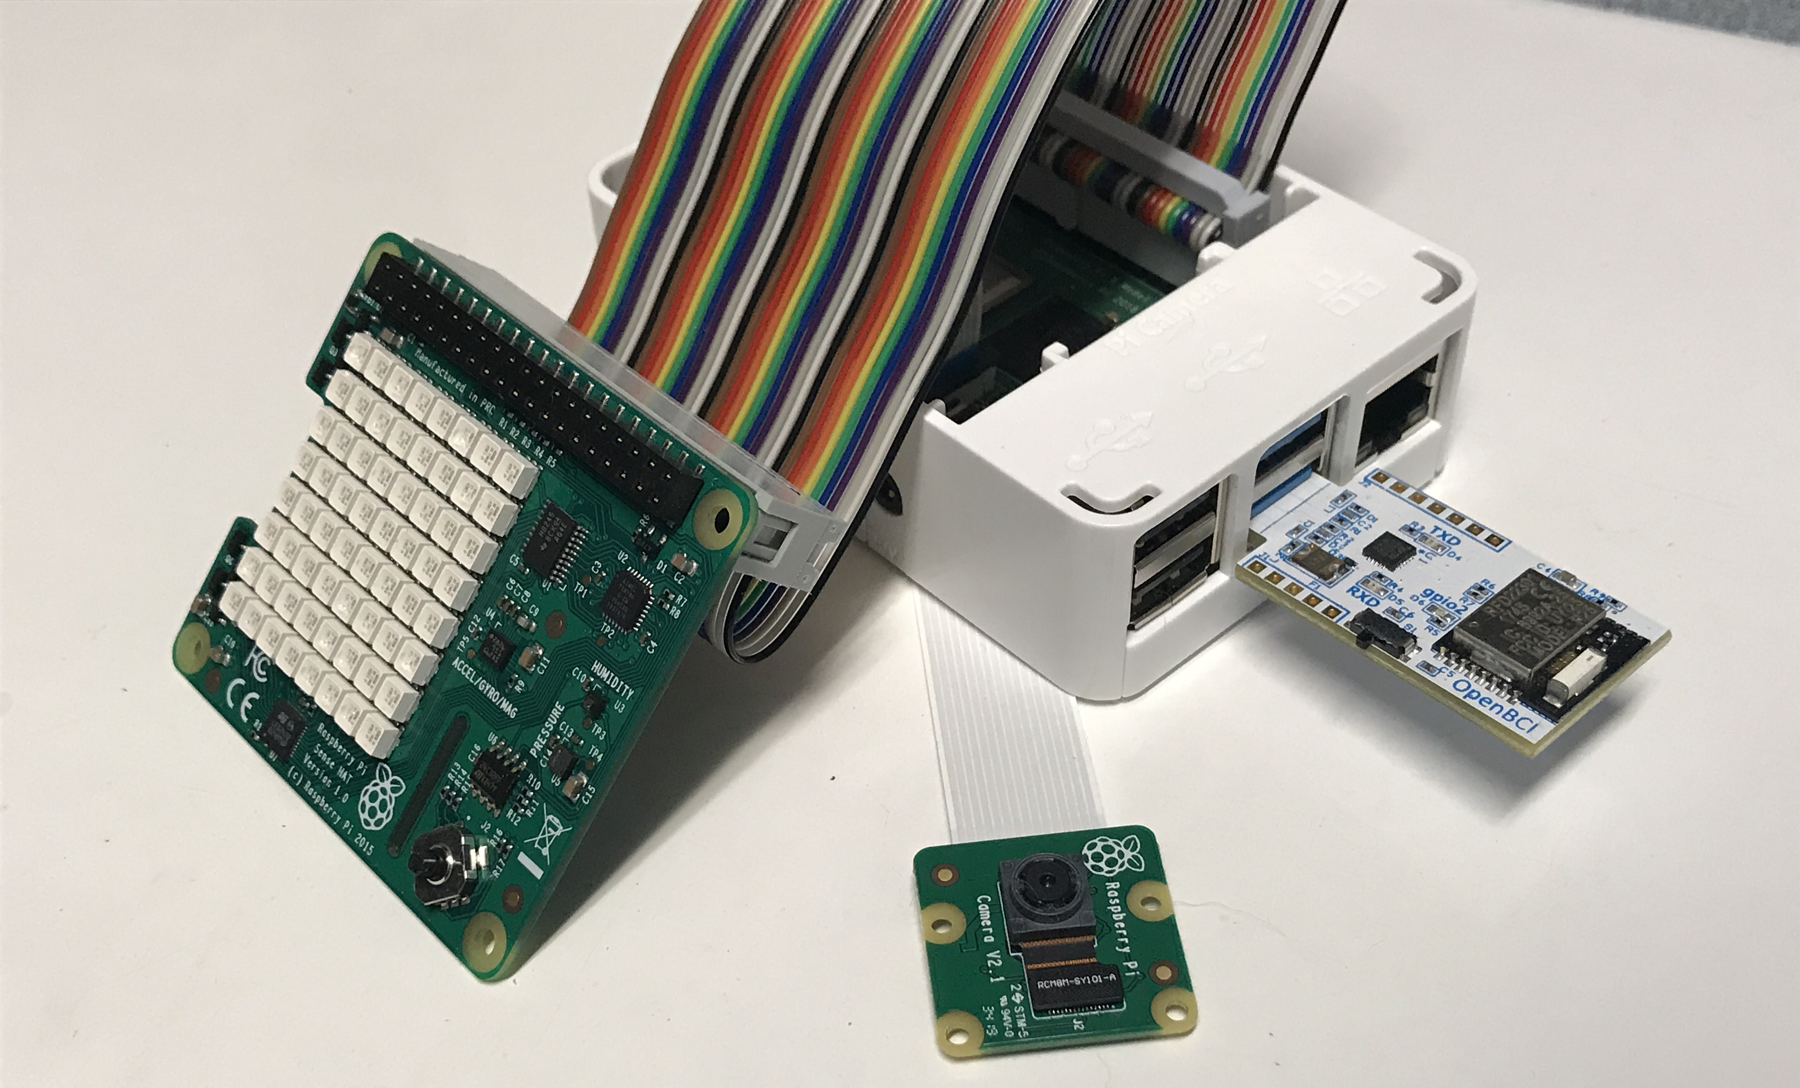
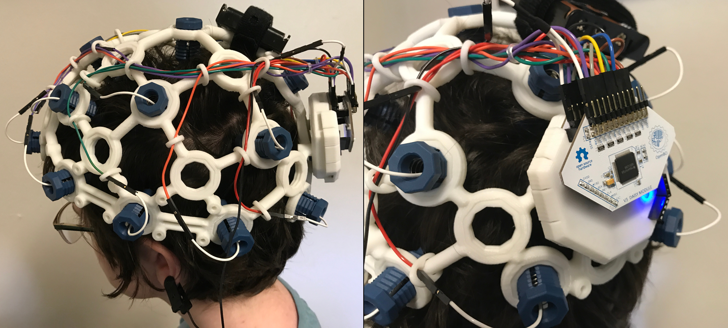
Progress
Current stage: building the framework
Pi Sense Hat streams temperature, humidity, pressure, and gyroscopic data
Picam streams a live video feed of subject
OpenBCI headset streams EEG data to its corresponding dongle on the Raspberry Pi.
All data streams are organized and packaged by the Pi, then streamed to our data-ingestion server for analysis.

Slide 6
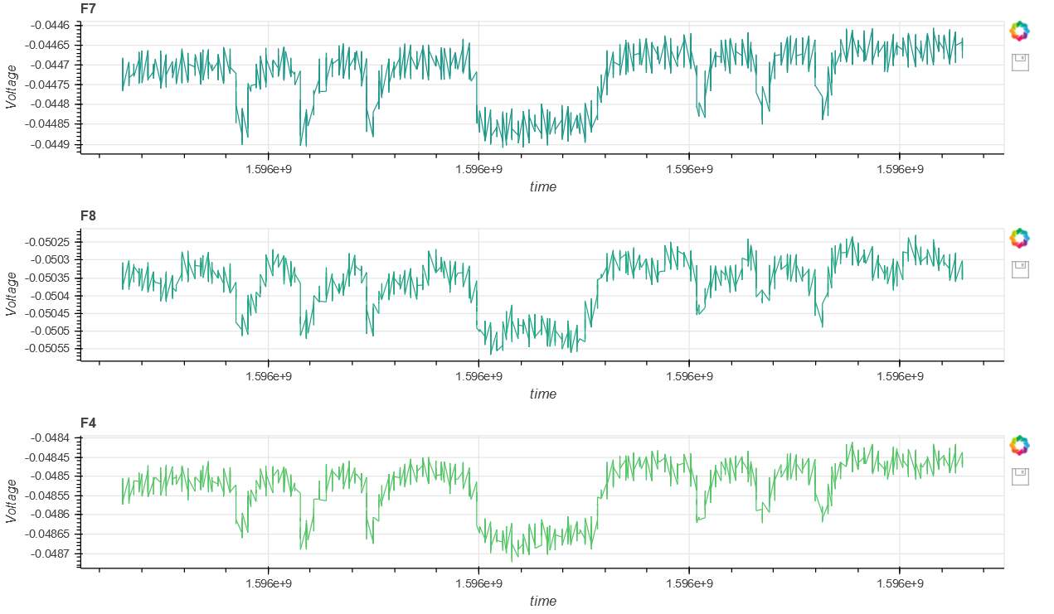
The data can then be directly viewed in a browser window after processing, along with a simple FFT analysis which will be used as input for the deep learning algorithm.

